Slide 1

REQUIREMENT & DESIGN
IN SOFTWARE DEVELOPMENT PROCESS
NGUYEN THE VINH – VINHNT37
29ST MARCH 2023

Slide 2
1
1
WHAT IS SOFTWARE ENGINEER? JOBS? DEVELOPMENT SKILLS?
AGENDA
2
SOFTWARE DEVELOPMENT PROCESS
2
MICROSERVICE?
© Copyright FPT Software – Level of Confidentiality

Slide 3

00. SOMETHING ABOUT MYSELF

Slide 4

INTRODUCTION
NGUYỄN THẾ VINH
(VINHNT37@fpt.com)
Project Manager at FPT Software
Education
FPT University
Japan System
2010
2014
2016
2020
9/2021
2023
Software Developer
Fsoft Developer
CEO PnS Solution Ltđ
Fsoft TeamLeader
Promote PM
still doing well

Slide 5
1
1
What is Software Engineering
2
Jobs Title
AGENDA
WHAT IS SOFTWARE ENGINEER? JOBS? DEVELOPMENT SKILLS?
3
DEVELOPMENT SKILLS?
4
Q&A
© Copyright FPT Software – Level of Confidentiality

Slide 6
01. WHAT IS SOFTWARE ENGINEERING

Slide 7
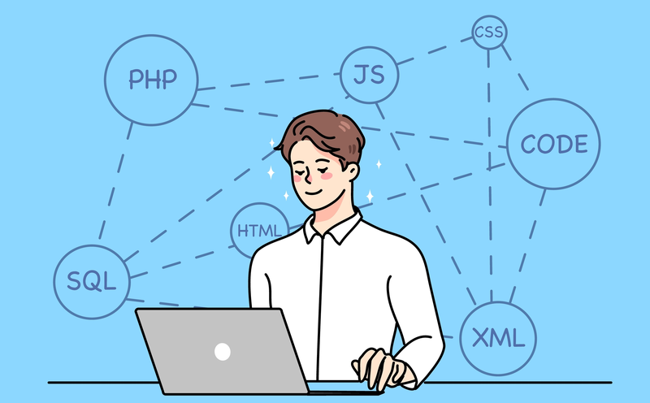
Software Engineering?
What is software engineering?
Software engineers are people who create software products and computer systems
A software engineer is a person who has a vision, as well as an overview of customers, companies, and human resources.
Must have the ability to think, create, manage as well as professional knowledge.
Software engineers also regularly exchange and discuss with customers, managers and related groups to create a complete software development plan.

Slide 8
02. Jobs Title

Slide 9
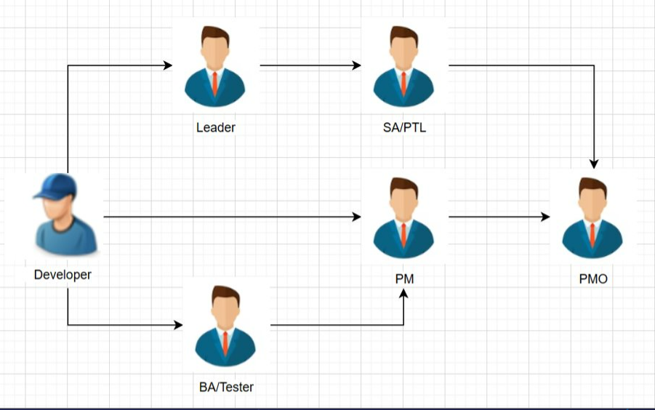
Jobs Title

Slide 10
03. Development Skills

Slide 11
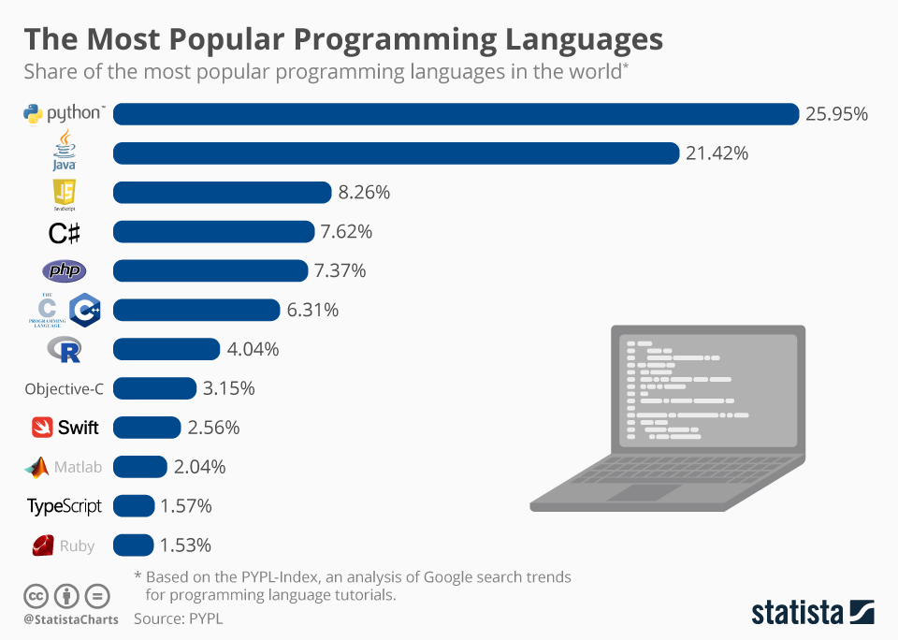
HARD SKILLS
Programming language

Slide 12
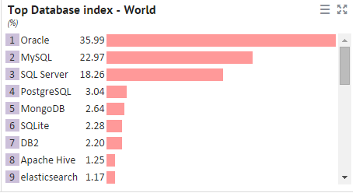
HARD SKILLS
Programming languages ​​Database processing

Slide 13
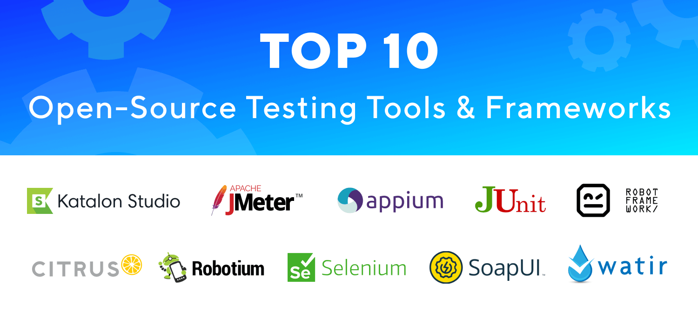
HARD SKILLS
Testing Skill

Slide 14
HARD SKILLS
Testing Skill

Slide 15
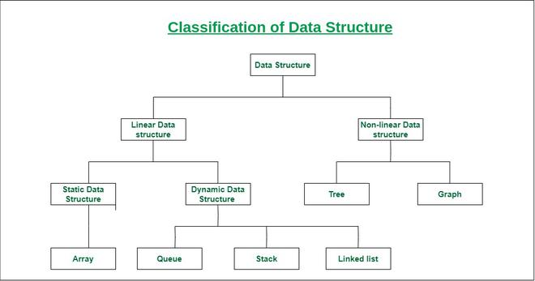
HARD SKILLS
Data structures and algorithms

Slide 16

SOFT SKILLS
Communicate

Slide 17

SOFT SKILLS
Curious and eager to learn

Slide 18
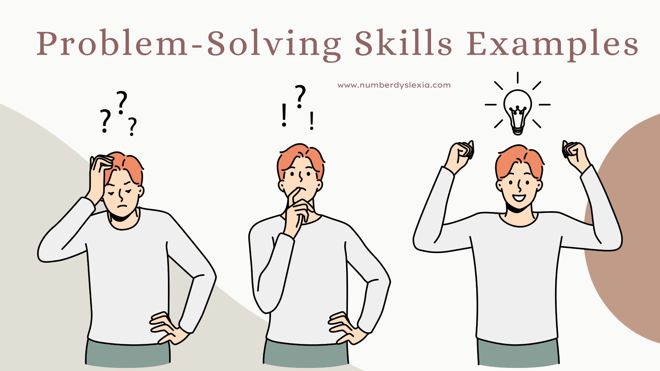
SOFT SKILLS
Solve problems and situations that arise

Slide 19
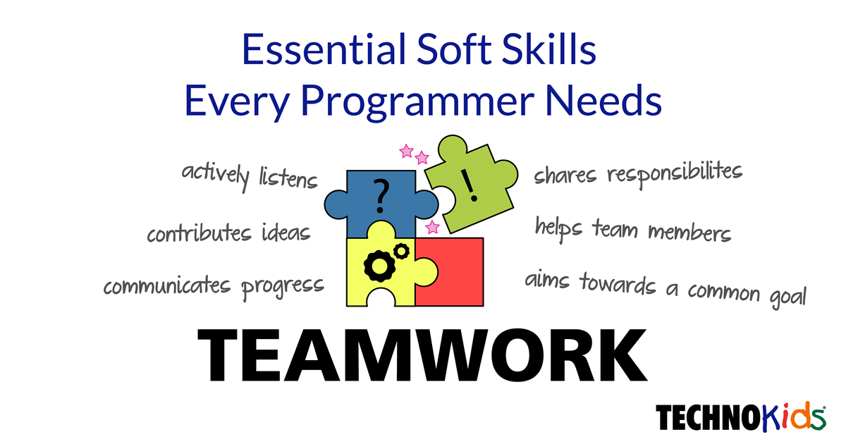
SOFT SKILLS
Teamwork skill

Slide 20
1
1
WATERFALL
2
SCRUM
AGENDA
SOFTWARE DEVELOPMENT PROCESS
© Copyright FPT Software – Level of Confidentiality

Slide 21
01. WATERFALL METHODOLOGY

Slide 22
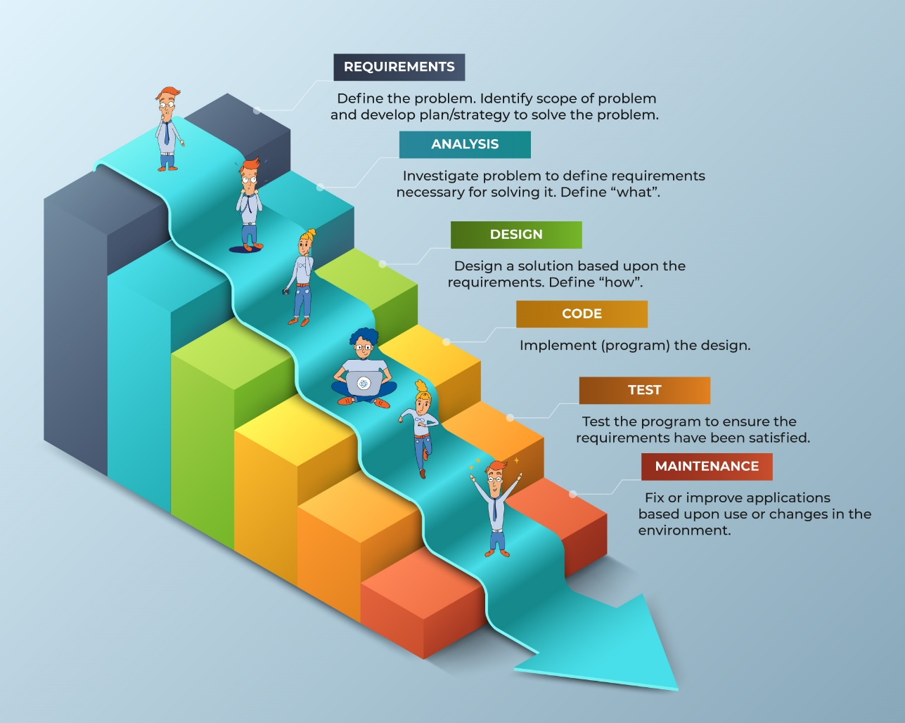

What is Waterfall Methodology
Defination
It is also referred to as a linear-sequential life cycle model.
In a waterfall model, each phase must be completed before the next phase can begin and there is no overlapping in the phases.

Slide 23
Advantages/Disadvantages of Waterfall
Advantages
Disadvantages
Emphasizes Structured Organization
Changes Can Be Implemented in Early Design Stages
Suitable for Deadline and Milestone-Oriented Teams
Accommodates for Shifting Teams
Allows for Accurate Cost Estimation
It’s Extremely Restrictive
Excludes Users/Clients from the Process
Delayed Testing

Slide 24
02. SCRUM METHODOLOGY

Slide 25
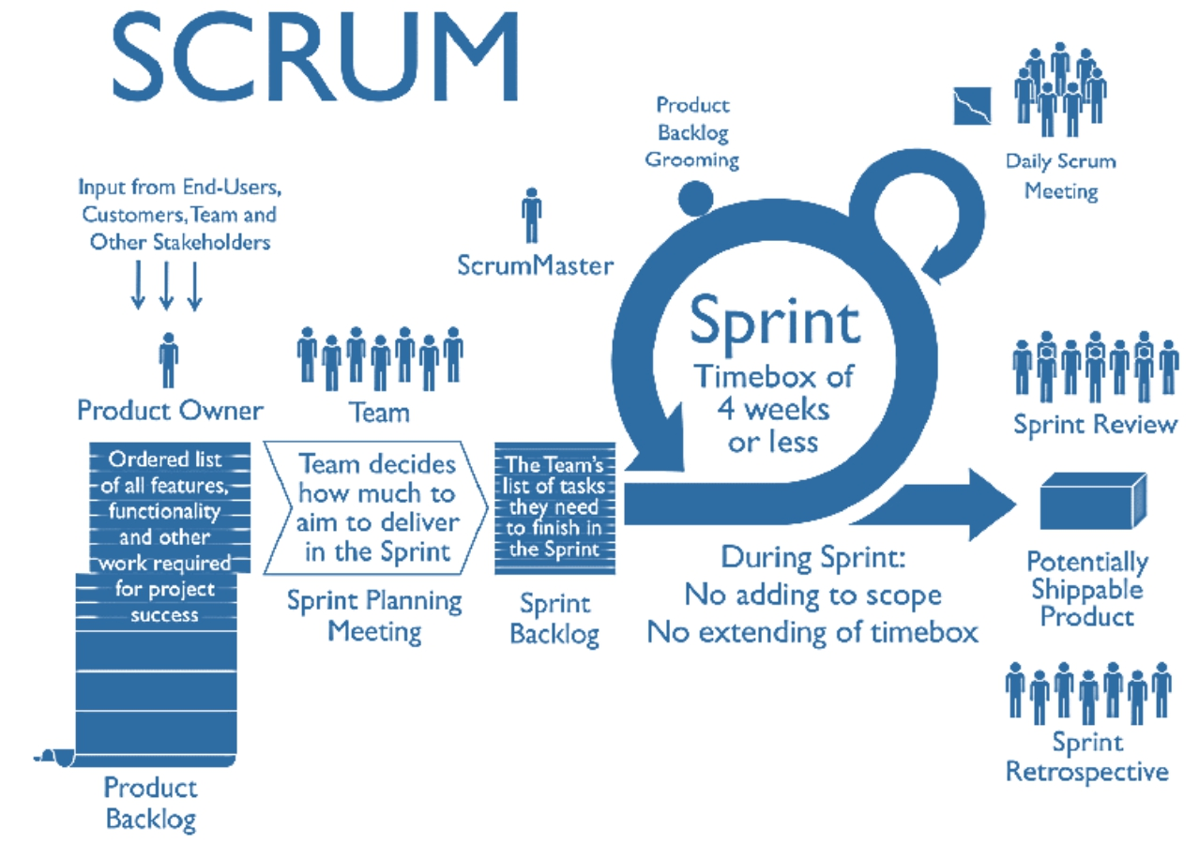
What is Scrum

Slide 26
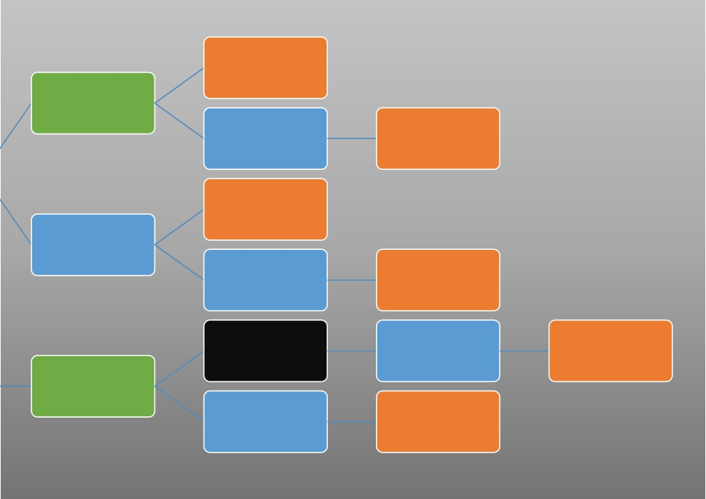
Scrum Item
User story
Epic/Theme
Feature User story
Idea
User story
Feature
Product Feature User story
Component Feature User Story
Idea Epic/Theme
Feature User story
Product Backlog

Slide 27
User Story
• As a <user type>, I want <some things/goals> so that <some reasons>
• 3 C’s
• Who
• Is it good story:
• As a developer, I want an API to work with my API
• All parameters (ref. doc) are correctly exposed
• Follow code standard and solution agreed
• No bugs

Slide 28
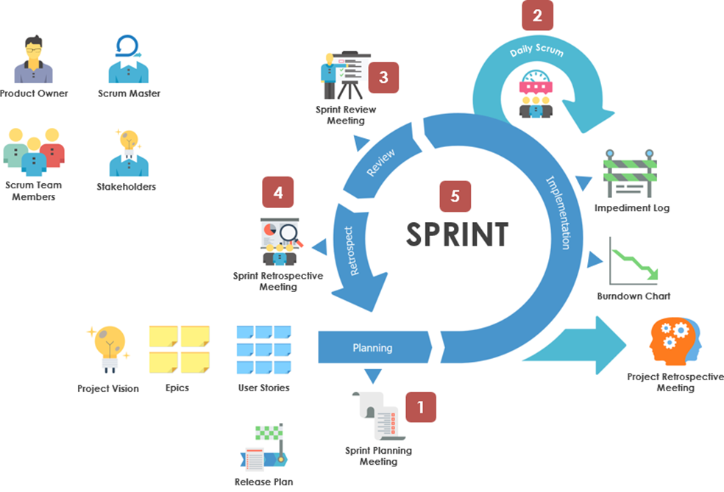
Scrum Process

Slide 29
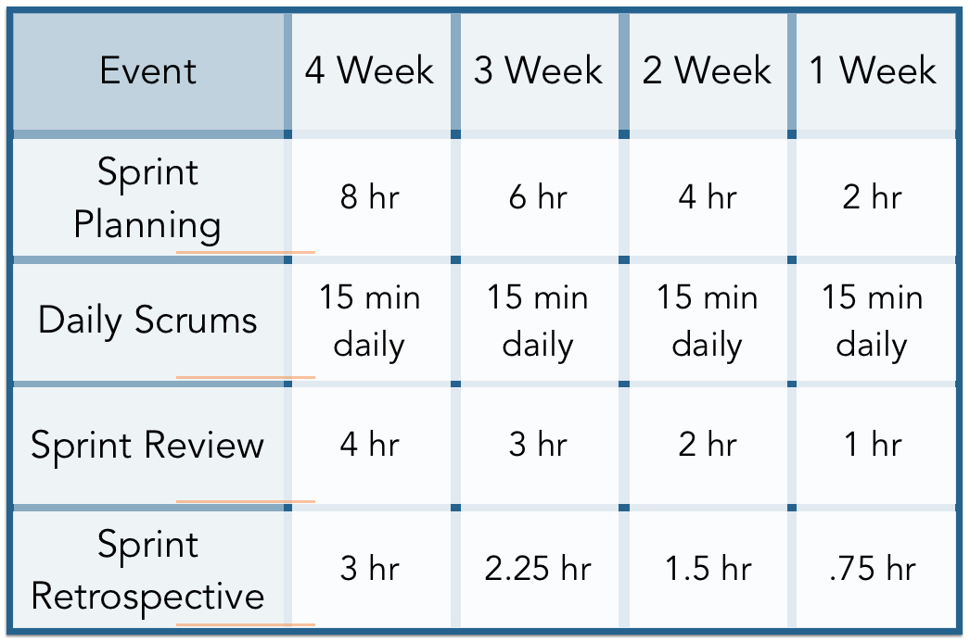
Scrum Events Time

Slide 30
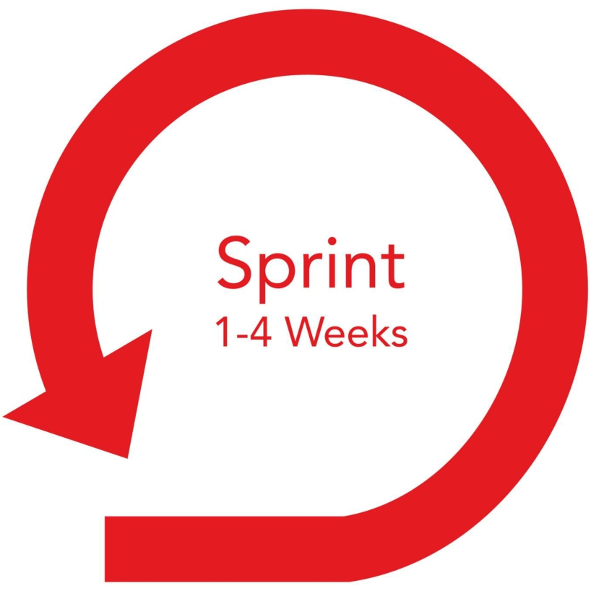
Scrum Timelines

Slide 31
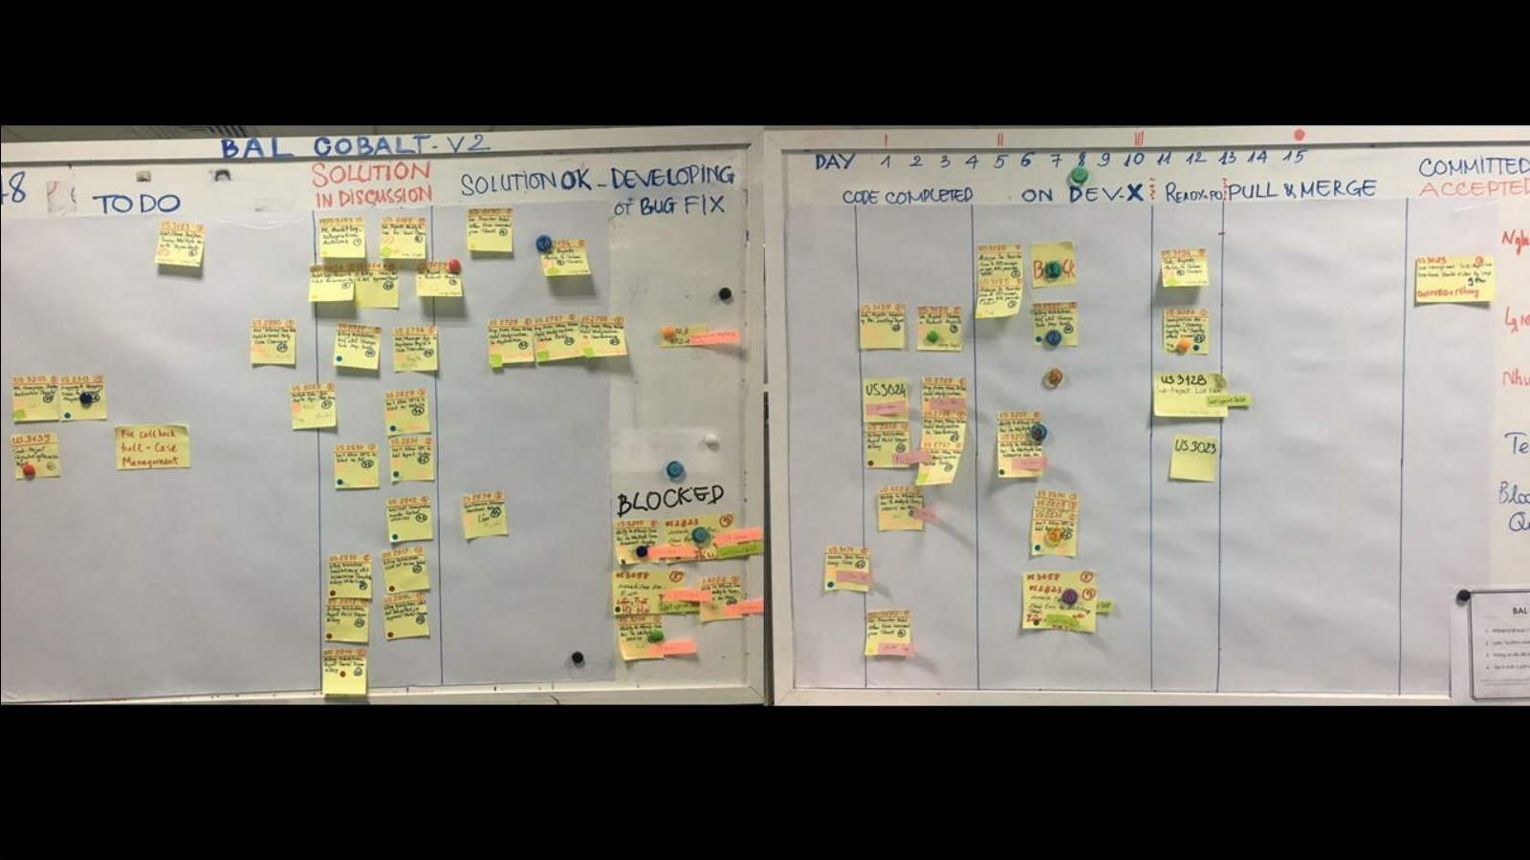

Slide 32
1
1
What is Microservice
2
Pros and Cons of Microservices
AGENDA
REQUIREMENT PROCESS
3
Microservices Application
4
Q&A
© Copyright FPT Software – Level of Confidentiality

Slide 33
01. What is Microservice

Slide 34
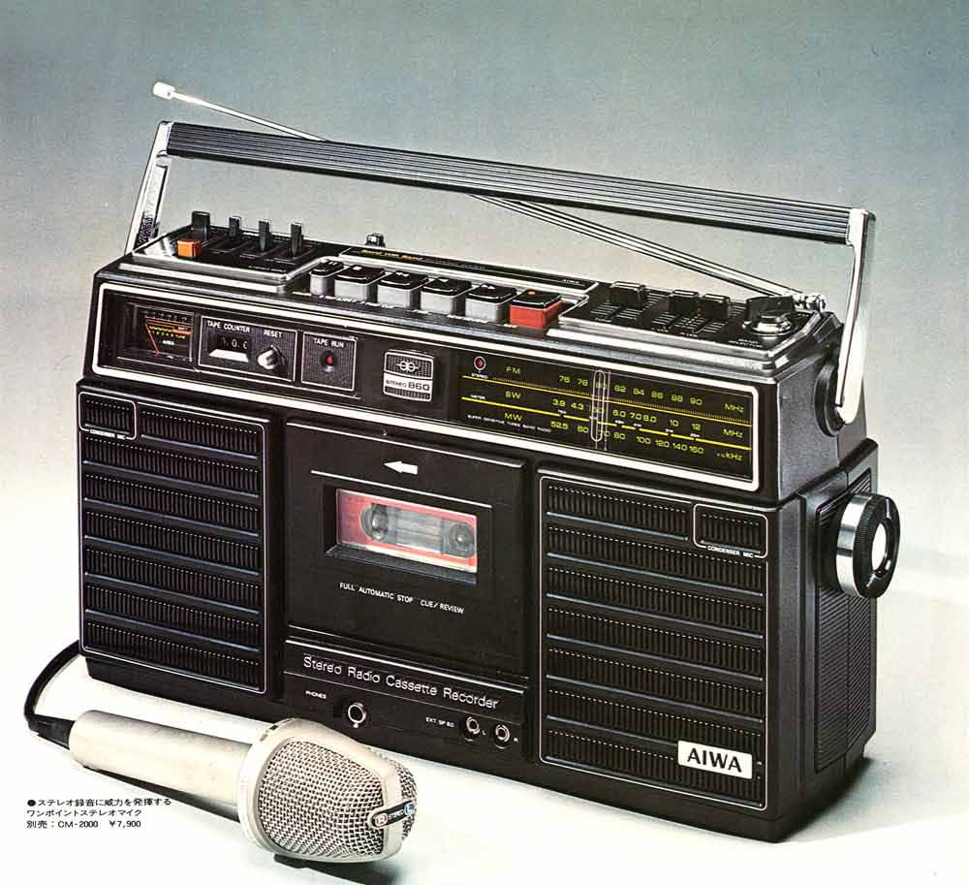
Monolithic Architecture
Everything is integrated

Slide 35
Monolithic Architecture
But, what happens if...
But, what happens if...
We want a double cassette
Or a CD player
Or a digital radio
...

Slide 36
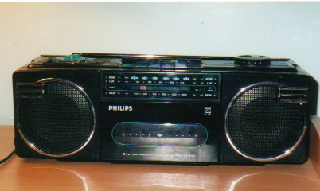
Monolithic Architecture
But, what happens if...
We have to change the whole thing

Slide 37
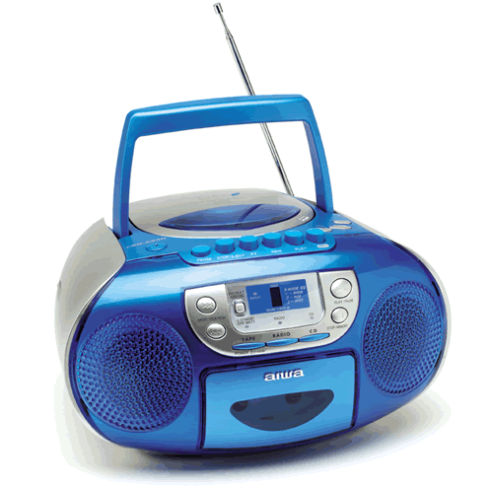
Monolithic Architecture
But, what happens if...
Again

Slide 38
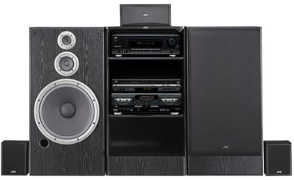
Monolithic Architecture
But, what happens if...
With Modular Applications

Slide 39
Monolithic Architecture
But, what happens if...
With Modular Applications
Each part is independent

Slide 40
Monolithic Architecture
But, what happens if...
Do you Need a CD Player?

Slide 41
Monolithic Architecture
But, what happens if...
Pros
Single language should develop simple, centralized source code.
There are many frameworks that support it.
- Debugging and testing is easier than because only on one IDE, one project.
Cons
Designed, developed and deployed in a single block
The monolithic application is complex and large making it difficult to maintain, upgrade and add new features
Difficult to adopt Agile development
Reliability: an unstable service can crash the whole system

Slide 42
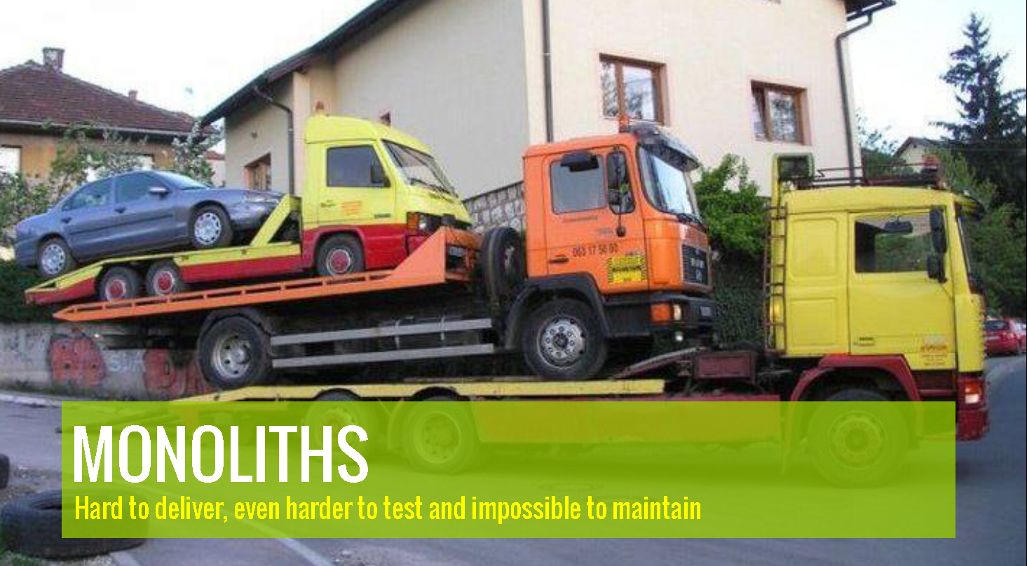
Monolithic Architecture

Slide 43
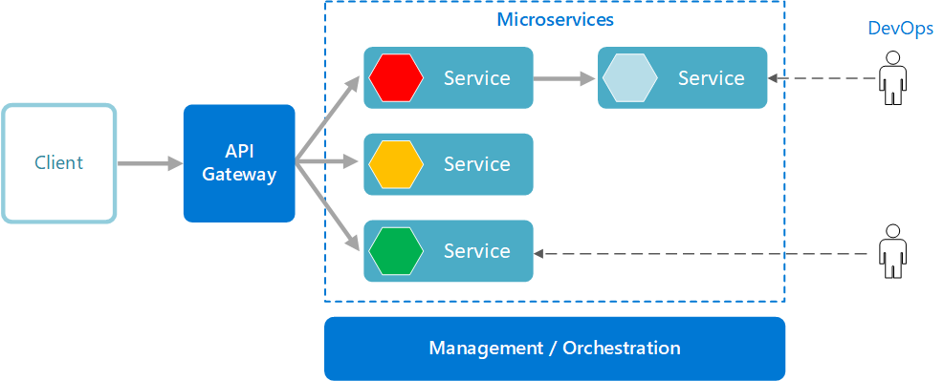
What is Microservice?
Divided into many component services.
Each service will be placed on a separate server
Adding new features only requires updating each respective microservices

Slide 44
What is Microservice?

Slide 45
What is Microservice?

Slide 46
02. Pros and Cons of Microservice

Slide 47
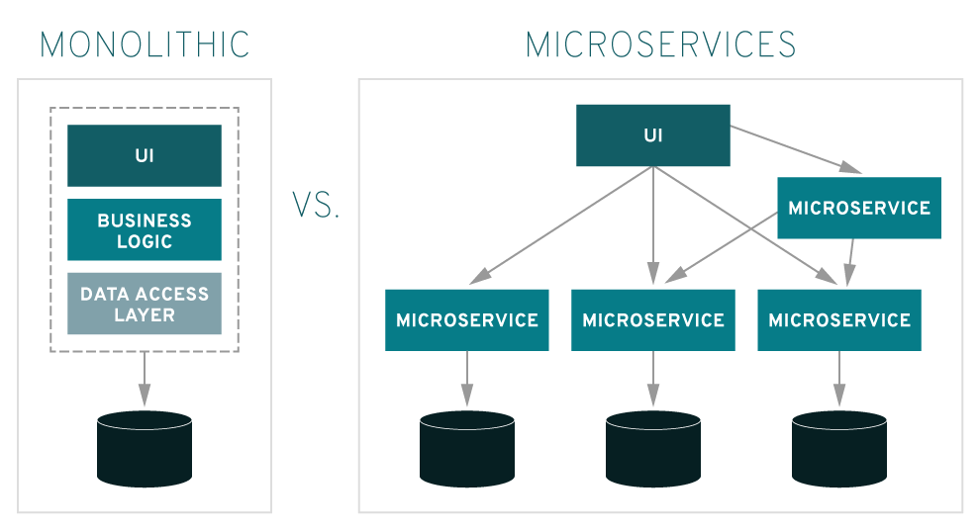
Pros Of Microservice
Easy to scale
Better fault tolerance
Easy to understand system codebase
Allows testing of many different technologies
Independently deploy each module
Easier testing capabilities

Slide 48
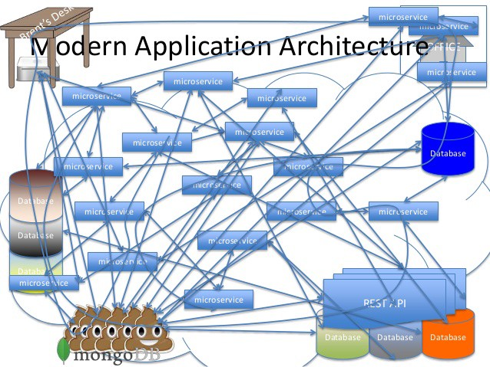
Cons Of Microservice
Modules communicate over the network so the speed may not be as high as monolith
Each module has to deal with security issues, transactions, connection errors, and log files management
Ensuring data uniformity becomes more complicated
Using many services, monitoring and managing these services will be more complicated

Slide 49
03. Microservice Application

Slide 50
WHAT YOU NEED TO BUILD MICROSERVICE ARCHITECTURE
Message Broker/ Message Bus/ Message QUEUE/ API

Slide 51
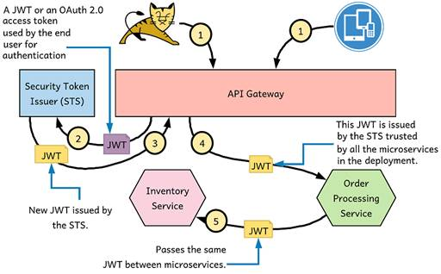
WHAT YOU NEED TO BUILD MICROSERVICE ARCHITECTURE
Authentication by JWT/OAuth

Slide 52
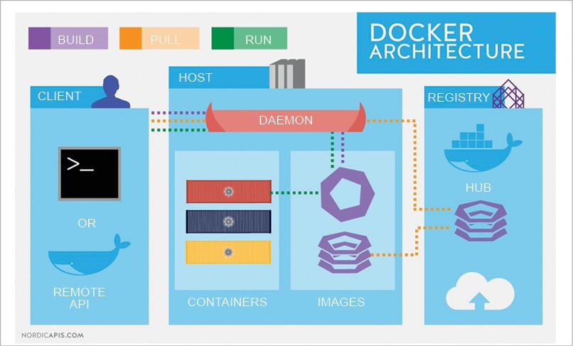
WHAT YOU NEED TO BUILD MICROSERVICE ARCHITECTURE
DOCKER

Slide 53
MICROSERVICE & MONOLITHIC USE
Monolithic
The requirements of the problem are small, the scalability in the future is small, the user audience is not much.
Team size is small, experience and knowledge are not much.
Requires rapid development, the faster the better.
Microservice
Team size is large and very large, enough human resources with knowledge and experience to develop.
The problem is big, the ability to expand and develop strongly, the user audience is very large or has great potential for development in the future.

Slide 54
04. Q&A

Slide 55

CONTACT US
FPT Software F-TOWN 3, 3 Đ. Võ Chí Công, Long Thạnh Mỹ, Thành Phố Thủ Đức, Thành phố Hồ Chí Minh Tel.: +84 (28) 3736 2323

